Slide 1
Windows 7 Training

Slide 2
Windows® 7 Graphic Overview: A Look at Direct2D and DirectWrite
Microsoft® Corporation

Slide 3
Agenda
Windows 7 graphics platform overview
Direct2D
DirectWrite
Summary

Slide 4
Windows 7: Usage of the GPU
Continues from Windows Vista®
Windows Media Center UI, video playback
Desktop Window Manager (DWM)
Windows 7 DWM uses Direct3D 10.1 API
Scales in performance all the way from low-end integrated to high-end GPUs
Uses shaders for blurs in the glass
Cuts memory consumption by 50% per window by optimizing DWM
Provides more and richer animations of the thumbnails
Major area of improvements
High DPI
High color

Slide 5
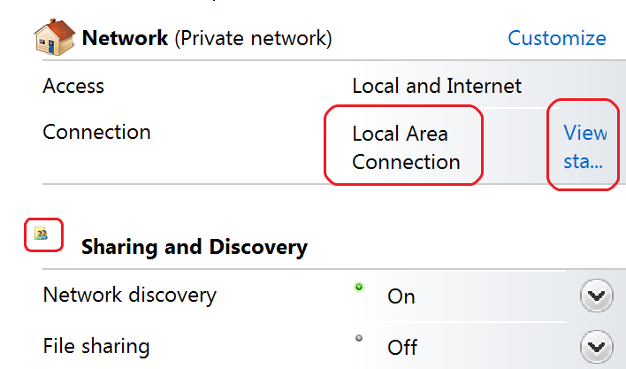
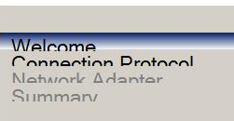
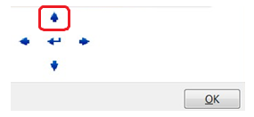
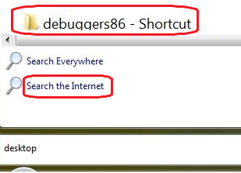
High DPI Issues
Clipped text
Layout issues and image size issues
Layout issues
Pixilated bitmaps
Mismatched font sizes
Blurry UI

Slide 6
DPI Virtualization
Feature introduced in Windows Vista
Applies to applications which do not declare DPI awareness
Via manifest or via SetProcessDPIAware()
Win32 subsystem returns system metrics calls as if the application were running at 96 DPI (values returned from GetSystemMetrics(), GetDeviceCaps, DEFAULT_GUI_FONT, and so on)
DWM scales the application window when it composes the desktop
DPI Virtualization is a stop-gap, not a solution

Slide 7
Windows 7 Graphics Platform Overview
Applications
Windows Paint
Taskbar
Third party
Frameworks
Ribbon
Animation
WPF
Primitives

Slide 8
Windows 7 Graphics Platform Overview
Direct2D
DWM
Direct
Write
WIC
Direct3D 10
Direct3D 11
DXVA
GDI+
DirectX Graphics Infrastructure
Direct3D9
USER
GDI
DXGKernel
Win32K
New in Windows 7
Exists in Windows Vista

Slide 9
Windows 7 Graphics Platform Overview
Windows 7 introduces few new APIs
APIs will be available for Windows Vista in the future
Newer (than GDI) programming model
Enable richer and higher performance graphics and text by leveraging the GPU where applicable
Enable easy interoperability between different APIs

Slide 10
API Interoperability
Windows Vista
Windows 7
//DX Code
CreateRenderTarget()
Draw()
Present()
// GDI Code
GetDC()
DrawLine()
ReleaseDC()
Copy 1
Copy 2

Slide 11
Direct2D Overview
Application
Application
Direct2D is built on top of Direct3D, which offloads rendering tasks to the GPU. You can still use software rendering (for server scenarios, for example).
Direct2D
Direct3D
Software rasterizer
DXGI

Slide 12
Direct2D Overview
High-performance, high-quality, immediate-mode rendering API built on Direct3D
Hardware or software rendering
Works on older DX9 cards with 10Level9 rendering
Useful for server rendering scenarios, can be used in session 0 service context
Rendering focused
2D vector graphics, bitmaps, and text
Delegates some GDI services to other newer APIs

Slide 13
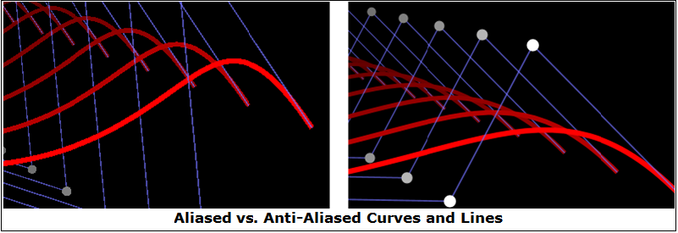
Direct2D Overview
High quality anti-aliased graphics with same or better performance as GDI
Without anti-aliasing, much better performance than GDI

Slide 14
Direct2D API
Resolution-independent coordinate system
Floating point values
Units of DIPs (DPI-independent pixels)
1 DIP at 96 DPI is one pixel
Affine transforms
Consists of three main object categories
Render targets (for example, HWND, HDC, Direct3D)
Device-independent resources
Created via ID2D1Factory
Device-dependent resources
Created via ID2D1RenderTarget
Become invalid if the target becomes invalid

Slide 15
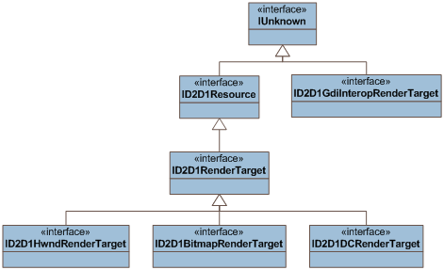
Direct2D API Interfaces Render Target Interfaces

Slide 16
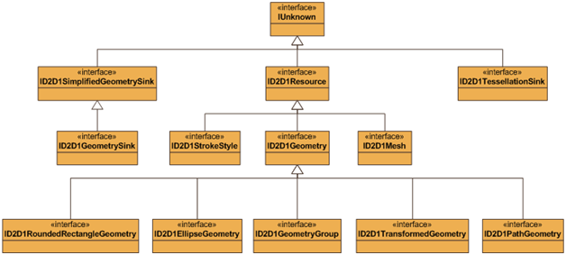
Direct2D API Interfaces Device-Independent Resource Interfaces

Slide 17
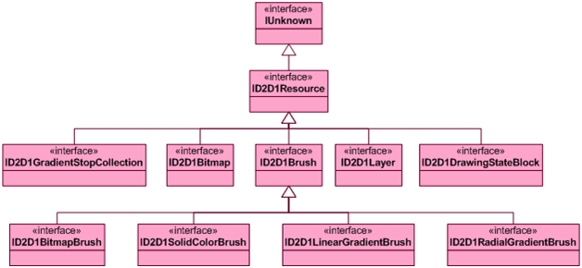
Direct2D API Interfaces Device-Dependent Resource Interfaces

Slide 18
Direct2D API Sample Usage
Create top-level objects and resources
D2D1CreateFactory() → ID2D1Factory
Factory → ID2D1Geometry
Populate geometry
Also bitmap, interoperability, and intermediate render targets
On WM_PAINT (cache DD objects created)
Factory → ID2D1HwndRenderTarget
Also brushes, bitmaps, layers
ID2D1HwndRenderTarget->BeginDraw()
FillGeometry(), DrawRectanble(), etc.
ID2D1HwndRenderTarget->EndDraw()
If return value == D2DERR_RECREATE_TARGET, recreate cached objects next time

Slide 19
Direct2D API Sample Usage
HRESULT hr;
ID2D1Factory *pFactory;
hr = D2D1CreateFactory(
D2D1_FACTORY_TYPE_SINGLE_THREADED,
&pFactory);
ID2D1PathGeometry *pPathGeometry;
ID2D1GeometrySink *pGeoSink;
hr = pFactory->CreatePathGeometry(&pPathGeometry);
hr = pPathGeometry->Open(&pGeoSink);
pGeoSink->SetFillMode(D2D1_FILL_MODE_ALTERNATE);

Slide 20
Direct2D API Sample Usage
pGeoSink->AddLine(D2D1::Point2F(200, 0));
pGeoSink->AddBezier(D2D1::BezierSegment(
D2D1::Point2F(150, 50),
D2D1::Point2F(150, 150),
D2D1::Point2F(200, 200)));
pGeoSink->AddLine(D2D1::Point2F(0, 200));
pGeoSink->AddBezier(D2D1::BezierSegment(
D2D1::Point2F(50, 150),
D2D1::Point2F(50, 50),
D2D1::Point2F(0, 0)));
pGeoSink->EndFigure(D2D1_FIGURE_END_CLOSED);
hr = pGeoSink->Close();

Slide 21
Direct2D API Sample Usage WM_PAINT code
RECT rc;
GetClientRect(m_hwnd, &rc);
D2D1_SIZE_U size = D2D1::SizeU(rc.right - rc.left,
rc.bottom - rc.top);
ID2D1HwndRenderTarget *pRT;
hr = pFactory->CreateHwndRenderTarget(
D2D1::RenderTargetProperties(),
D2D1::HwndRenderTargetProperties(m_hwnd, size),
&pRT);
ID2D1SolidColorBrush *pGreenBrush;
hr = pRT->CreateSolidColorBrush(
D2D1::ColorF(D2D1::ColorF::Green),
&pGreenBrush);

Slide 22
Direct2D API Sample Usage WM_PAINT code
if (!(pRT->CheckWindowState()
& D2D1_WINDOW_STATE_OCCLUDED))
{
pRT->BeginDraw();
pRT->SetTransform(
D2D1::Matrix3x2F::Identity());
m_spRT->Clear(D2D1::ColorF(
D2D1::ColorF::White));
pRT->FillGeometry(pPathGeometry,
pGreenBrush);
hr = pRT->EndDraw();
}

Slide 23
Direct2D Interoperability with GDI
HDC from Direct2D render target
Create GDI-compatible render target
D2D1_RENDER_TARGET_USAGE_GDI_COMPATIBLE
D2D1_COMPATIBLE_RENDER_TARGET_OPTIONS_GDI_COMPATIBLE
QI for IGdiInteropRenderTarget
GetDC()
ReleaseDC()
Direct2D render target from HDC
CreateDCRenderTarget()
ID2D1DCRenderTarget::BindDC()

Slide 24
Direct2D Interoperability with Direct3D
Use a Direct3D 10 or 10Level9 device
Map Direct3D surface to Direct2D render target
CreateDxgiSurfaceRenderTarget()
Call EndDraw() before Present()
Works in all hardware configurations
Best with Windows Display Driver Model (WDDM) 1.1 drivers and DX10 GPU

Slide 25
Windows 7 Graphics
Demo
Direct2D in action

Slide 26
DirectWrite

Slide 27
DirectWrite Architecture
Application
DirectWrite
Graphics API
Text Layout API
Font System
Script Processor
Font Rasterizer
DirectWrite is a layered API. Text layout API provides the highest level functionality. Use the lower level script processor and font rasterizer APIs if you’re writing your own layout engine or need more control over how text renders. The font system is available on all levels. DirectWrite is rendering API independent.

Slide 28
DirectWrite Overview
Modern typography
Supports all OpenType features
Works with any rendering technology
GDI, Direct2D, Direct3D
Enables world-wide applications
Most complete script support
Hardware accelerated with Direct2D
ClearType filter and blend performed in hardware
Reduced CPU usage when drawing glyphs

Slide 29
DirectWrite OpenType® Features
Capitals to small caps Superscript Scientific inferiors Subscript Ordinals Titling alternates Swash Contextual swash Contextual alternates Proportional old style Tabular lining Proportional lining Tabular old style Standard ligatures Discretionary ligatures Historical ligatures Case-sensitive forms | Small caps Contextual ligatures Fractions Alternative fractions Stylistic alternates Stylistic sets Historical forms Slashed zero Alternate annotation Mathematical Greek Localized forms Petite caps Capitals to petite caps Unicase Glyph de/composition Required ligatures Mark positioning | Mark-to-mark positioning Ruby notation forms Expert forms Proportional widths Full widths Half widths Third widths Quarter widths Simplified forms Traditional forms Traditional name forms NLC Kanji forms Hojo Kanji forms JIS 78 forms JIS 83 forms JIS 90 forms JIS 04 forms
Every font feature can be accessed via a four-byte name tag

Slide 30
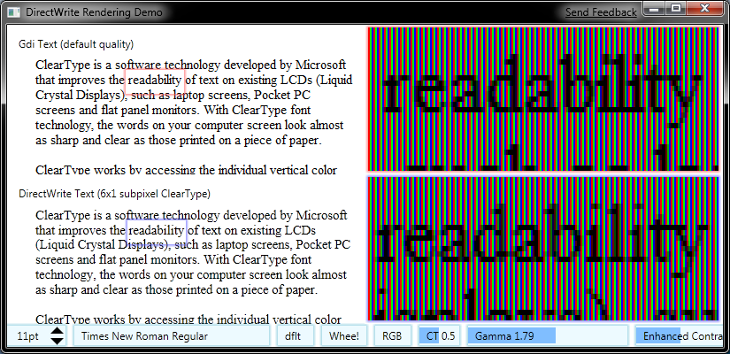
Text Positioning
Can start glyphs at a sub-pixel boundary
Enables more even spacing between glyphs
Smoother scrolling and text rotation

Slide 31
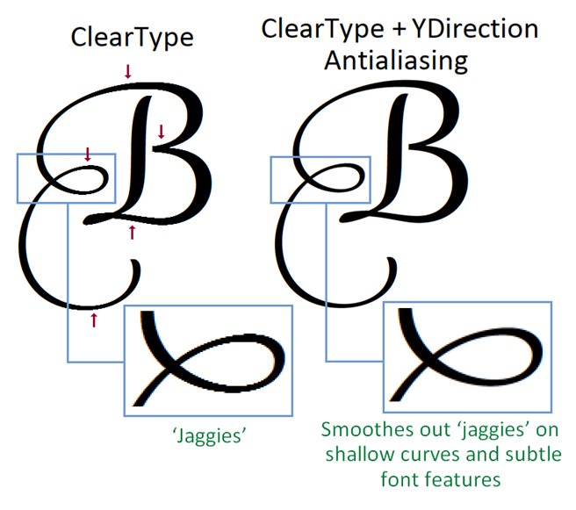
ClearType
In GDI, ClearType only works in the x-direction
DirectWrite also smoothes text in the y-direction by blending

Slide 32
DirectWrite API Basic Usage
Create factory object
DWriteCreateFactory → IDWriteFactory
Factory creates all other objects
Create text format
IDWriteTextFormat
Specifies paragraph formatting attributes
Create layout
IDWriteTextLayout
Applies format to string given layout rectangle
Draw layout to render target
ID2D1RenderTarget::DrawTextLayout

Slide 33
DirectWrite API Basic Usage
HRESULT hr;
ID2D1Factory *pD2DFactory;
IDWriteFactory *pDWFactory;
D2D1CreateFactory(D2D1_FACTORY_TYPE_SINGLE_THREADED,
&pD2DFactory);
DWriteCreateFactory(DWRITE_FACTORY_TYPE_SHARED,
__uuidof(IDWriteFactory),
reinterpret_cast<IUnknown**>(&pDWFactory));
LPWSTR wszText = L"Hello World using DirectWrite!";
UINT32 cTextLength = wcslen(wszText);

Slide 34
DirectWrite API Basic Usage
IDWriteTextFormat *pTextFormat;
pDWFactory->CreateTextFormat(L"Gabriola", NULL, DWRITE_FONT_WEIGHT_REGULAR,
DWRITE_FONT_STYLE_NORMAL, DWRITE_FONT_STRETCH_NORMAL,
72.0f, L"en-us", &pTextFormat);
hr = pTextFormat->SetTextAlignment(
DWRITE_TEXT_ALIGNMENT_CENTER);
hr = pTextFormat->SetParagraphAlignment(
DWRITE_PARAGRAPH_ALIGNMENT_CENTER);

Slide 35
DirectWrite API Basic Usage WM_PAINT code
RECT rc;
GetClientRect(m_hwnd, &rc);
D2D1_SIZE_U size = D2D1::SizeU(rc.right - rc.left,
rc.bottom - rc.top);
ID2D1HwndRenderTarget *pRT;
hr = pD2DFactory->CreateHwndRenderTarget(
D2D1::RenderTargetProperties(),
D2D1::HwndRenderTargetProperties(m_hwnd, size),
&pRT);
ID2D1SolidColorBrush *pBlackBrush;
hr = pRT->CreateSolidColorBrush(D2D1::ColorF(
D2D1::ColorF::Black), &pBlackBrush);

Slide 36
DirectWrite API Basic Usage WM_PAINT code
if (!(pRT->CheckWindowState() & D2D1_WINDOW_STATE_OCCLUDED))
{
pRT->BeginDraw();
pRT->SetTransform(D2D1::Matrix3x2F::Identity());
pRT->Clear(D2D1::ColorF(D2D1::ColorF::White));
D2D1_RECT_F layoutRect = D2D1::RectF(
(float) rc.top, (float) rc.left,
(float) (rc.right - rc.left),
(float) (rc.bottom - rc.top));
pRT->DrawText(wszText, cTextLength,
pTextFormat, layoutRect, pBlackBrush);
hr = pRT->EndDraw();
}

Slide 37
DirectWrite API Font System
Collection (IDWriteFontCollection)
System collection: installed fonts
Family (IDWriteFontFamily)
Set of stylistically-related fonts
For example, Franklin Gothic
Font (IDWriteFont)
Provides font metrics and information
For example, Franklin Gothic, Bold, Italic
Font face (IDWriteFontFace)
Glyph metrics, rasterization, and outlines

Slide 38
Rendering with Direct2D
Draw with ID2D1RenderTarget methods
DrawText() for simple UI text
DrawTextLayout() for cached layouts
DrawGlyphRun() for custom layouts
Create geometry from glyph run
IDWriteFontFace::GetGlyphRunOutline()
Accepts ID2D1GeometrySink

Slide 39
Custom Rendering
Create objects
Factory, text format, layout
Custom renderer (IDWriteTextRenderer)
Render layout with renderer
IDWriteTextLayout::Draw()
Get glyph run outline at each call back
IDWriteFontFace::GetGlyphRunOutline()
Draw geometry with Direct2D

Slide 40
Interoperability Services
GDI-compatible metrics and rasterization
HFONT from IDWriteFont/IDWriteFontFace
IDWriteGdiInterop::ConvertFontToLOGFONT()
IDWriteGdiInterop::ConvertFontFaceToLOGFONT()
IDWriteFont/IDWriteFontFace from GDI font
IDWriteGdiInterop::CreateFontFromLOGFONT()
IDWriteGdiInterop::CreateFontFaceFromHdc()
Uses currently selected HFONT from HDC
DirectWrite-based rendering, GDI-based layout
Glyph run rasterizer
IDWriteBitmapRenderTarget::DrawGlyphRun()
Renders glyphs in software to a 32bpp bitmap
Useful for GDI rendering

Slide 41
Windows 7 Graphics
Demo
DirectWrite in action

Slide 42
Summary
Direct2D benefits
Direct2D API
Interoperability
DirectWrite API
Interoperability

Slide 43
Direct2D and DirectWrite
Q & A
…everything you were afraid to ask

Slide 44
Direct2D and DirectWrite
Hands-on Lab

Slide 45
© 2007 Microsoft Corporation. All rights reserved. Microsoft, Windows, Windows Vista and other product names are or may be registered trademarks and/or trademarks in the U.S. and/or other countries.
The information herein is for informational purposes only and represents the current view of Microsoft Corporation as of the date of this presentation. Because Microsoft must respond to changing market conditions, it should not be interpreted to be a commitment on the part of Microsoft, and Microsoft cannot guarantee the accuracy of any information provided after the date of this presentation. MICROSOFT MAKES NO WARRANTIES, EXPRESS, IMPLIED OR STATUTORY, AS TO THE INFORMATION IN THIS PRESENTATION.

