Slide 1
Microsoft Azure palvelualusta
Azure kumppanijulkistus,
16.12.2009, 8:30 - 12:00
Microsoft, Keilaranta 7, Espoo
Juhani Vuorio, Microsoft Oy
Juhani.vuorio@microsoft.com

Slide 2
Types of Cloud Computing
Cloud Platform
Software as a Service (SaaS)
Attached Service
Infrastructure or Platform as a Service
Application
Additional
functionality
Application
Platform
Local application platform
Browser/
HiFi UI
Application
Application

Slide 3
What is a cloud platform?
Self Service
Service Centric Approach
Auto-
mated
Manage-
ment
Cloud Applications
Usage
Based
Billing
Dynamic Computing Infrastructure

Slide 4



















Azure Platform
Developer Experience
Use existing skills and tools
Third party
languages
Web applications
Web and clouds
Third party cloud
Compute
Storage
Management
Relational data
Management
Connectivity
Inter-
operability
Access
control
Composite applications
On-premises
On-premises systems

Slide 5









Azure is Interoperable
Azure™ Services Platform
ATOM
XML
REST
Web Services

Slide 6
Commercial Launch
Feb 1
Paid usage
Jan
Commercial platform
Now
CTP with launch feature set

Slide 7

























Momentum
“ ... It’s become much clearer that
Windows Azure will change the
cloud computing landscape.”
“ ... I think it’s a very visionary,
pragmatic idea... And Microsoft has delivered with incredible speed. Can anyone touch them? ”
— David Smith
eduify | write faster

Slide 8
Microsoft Codename “Dallas”
Information Services

Slide 9
Introducing “Dallas”
Content Brokerage and Discovery platform
  Discover, Explore, and Use any type of content (blobs, structured, real-time web services)
  Tap into an ecosystem of global content providers
  Process & analyze data
Empowers developers of all sizes
Built on Windows Azure and SQL Azure

Slide 10

Workload Patterns Optimal For Cloud
“On and Off “
“Growing Fast“
Inactivity
Period
Compute
Compute
Average
Usage
Average Usage
Time
Time
  On & off workloads (e.g. batch job)
  Over provisioned capacity is wasted
  Time to market can be cumbersome
  Successful services needs to grow/scale
  Keeping up w/ growth is big IT challenge
  Complex lead time for deployment
“Unpredictable Bursting“
“Predictable Bursting“
Compute
Compute
Average Usage
Average Usage
Time
Time
  Unexpected/unplanned peak in demand
  Sudden spike impacts performance
  Can’t over provision for extreme cases
  Services with micro seasonality trends
  Peaks due to periodic increased demand
  IT complexity and wasted capacity

Slide 11
Real World TCO Analysis
(TCO estimate over 3-year period)
Persistent Systems
Alinean Inc.
  Public sector governance suite of applications & services
  Needs secure, scalable, elastic, & comprehensive platform
  Leading provider of B2B sales & marketing solutions to F100
  Reduce IT complexity & shift resources to core businesses
16%
49%
$74K
$62K
$540K
$277K
Lower TCO from dynamic scaling & automated service management
Lower TCO from efficient utilization of resources & service management

Slide 12
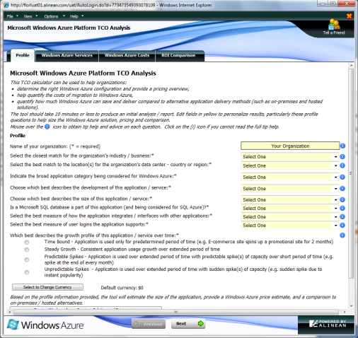
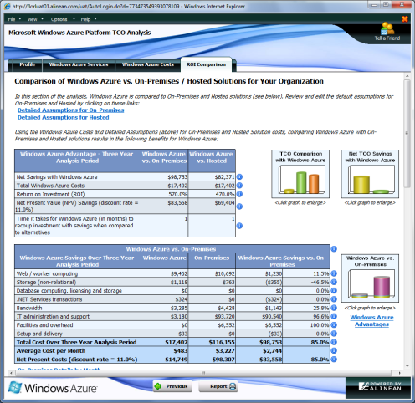
TCO Analyzer Tool
  Quickly determine “quantitative” value of using Windows Azure Platform services
  TCO of development and running Windows Azure Platform vs. traditional delivery channels
  Estimation “of” and conversion “to” on-premise solution to Windows Azure Platform services
TCO tool available today
http://www.microsoft.com/windowsazure/tco/

Slide 13



Windows Azure Platform Purchasing Models
Consumption
Subscription
Additional Licensing
“Pay as you go and grow”
“Value for a commitment“
“Coordinated purchasing”
Available Jan 2010
Select offers available Jan 2010
Planned for post PDC
Low barrier to entry & flexibility
Optimized for cloud elasticity
Discounts for commitment
Plans for payment predictability
Centralized purchasing experience
Introduction to volume discounts
Promotional
Offers
Development
Pricing
Partner
Discount
Integration with
Programs

Slide 14


Windows Azure Platform Consumption Prices
  Pay as you go and grow for only what you use when you use it
Elastic, scalable, secure, & highly available automated service platform
Highly available, scalable, and self managed distributed database service
  Compute
  Storage
  Web Edition
  Business Edition
Per service hour
$9.99/month
(up to 1 GB DB/month)
$99.99/month
(up to 10 GB DB/month)
Per GB stored & transactions
Per database/month
Per database/month
$0.12/hour
+ Variable Instance Sizes
$0.15 GB/month
$0.01/10K transactions
Windows Azure platform AppFabric Service Bus & Access Control
Scalable, automated, highly available services for secure connectivity
  Access Control
  Service Bus
$0.015/10k Message Operations
$0.015/10k Message Operations
Per Message Operation
Per Message Operation
Prices shown in USD only
International prices are available

Slide 15
Windows Azure Instance Sizes
  Variable instance sizes to handle complex workloads of any size
  Small
  Medium
  Large
  X Large
$0.12
$0.24
$0.48
$0.96
Per service hour
Per service hour
Per service hour
Per service hour
Unit of Compute Defined
  Equivalent compute capacity of a 1.6Ghz processor (on 64bit platform)
  Small
  Medium
  Large
  X-Large
1 x 1.6Ghz
2 x 1.6Ghz
4 x 1.6Ghz
8 x 1.6Ghz
(moderate IO)
(high IO)
(high IO)
(high IO)
1.75 GB memory
3.5 GB memory
7.0 GB memory
14 GB memory
250 GB storage
(instance storage)
500 GB storage
(instance storage)
1000 GB storage
(instance storage)
2000 GB
(instance storage)

Slide 16






Windows Azure Platform Data Transfer
Priced per GB transferred/month (prices shown in USD)
North America Region
Europe Region
Asia Pacific Region
$0.10 GB Ingress
$0.15 GB Egress
$0.10 GB Ingress
$0.15 GB Egress
$0.30 GB Ingress
$0.45 GB Egress
N. Europe
Sub-region
N. Central – US
Sub-region
W. Europe
Sub-region
E. Asia
Sub-region
S. Central - US
Sub-region
S.E. Asia
Sub-region
  No Charge For Off Peak Ingress Promotion (ends 6/30/10)
On-board to Windows Azure platform at no charge
Off peak times defined as: 10pm-6am Mon-Fri & from 10pm-Fri to 6am-Mon for weekends in each designated regional time zones below
North America
PST = UTC-8
Europe
WET = UTC
Asia Pacific
SST = UTC+8

Slide 17
Promotional Offers & Programs
Introductory
Special
MSDN
Premium
Biz Spark
One
Anyone can try the platform at no charge (monthly service allocations)
Subscribers receive monthly allocation of platform services at no additional charge
Investing in high potential start-ups; receive full platform services at no charge
  Development Accelerator
Core
Extended
  1. Accelerate cloud development projects
  2. Flexible consumption (flex # of instances)
  3. Predictable payments (6 mo subscription)
  4. Exceptional value (discounted price)
Includes Windows Azure compute, storage, storage transactions, data transfer, & message operations
Includes Core plus SQL Azure Business Edition

Slide 18
Promotional Offers & Programs
Introductory
Special
Biz Spark One
Offer
MSDN
Premium
Available to all partners & customers
Limit of one per customer
Promotion ends 6/30/10
Overage charged at Consumption rates
Available for selected startups
Program participation is by invitation only
Program available in 10 countries
MSDN Premium subscribers
Limit of one per MSDN subscription
8 month term
Limited time offer thru 7/31/10
Overage at partner Consumption rates
  Amount of Windows Azure platform services included per month at no charge
Windows Azure
Compute 25 Hrs
Storage 0.5 GB
Storage X-actions 10K
SQL Azure
1 Web Edition DB
(1GB DB for 90 day trial)
Message Operations
Messages 100K
Data transfer
0.5 GB In & 0.5GB Out
Amount of Windows Azure Platform services will vary by customer
Windows Azure
Compute 750 hrs
Storage 10 GB
Storage X-actions 1M
SQL Azure
3 Web Edition DB
(1 GB)
Message Operations
Messages 1 Million
Data transfer
7GB In & 14GB Out N.A/EU
2.5GB In / 5GB Out Asia Pacific
Additional 5% off for partners
(except storage & data transfers)

Slide 19
Development Accelerator Offer
6 month subscription offered at 42%-46% off consumption prices
Offered as a monthly “unit” (you can order multiple “units”)
Overage charged at Consumption rates
Promotional offer, expires 6/30/2010 for new subscriptions
CORE
EXTENDED
Windows Azure
Compute 750 hrs
Storage 10 GB
Storage X-actions 1M
Message Operations
Messages 1 M
Includes CORE plus
SQL Azure
Business Edition (10 GB)
Data transfer
7GB In/14GB Out N.A & EU
2.5GB In/5GB Out Asia Pacific
  Monthly price
  Monthly price
$59.95
(42% off consumption prices)
$109.95
(46% off consumption prices)
Additional 5% off for partners
(except storage & data transfers)

Slide 20
The Value of Service Management
Reduce IT
Complexity
  Shift valuable resources to focus on high value areas
Lower
TCO
  Reduce infrastructure and operational costs
Automated
Management
  Automated service management means automatic
  upgrades & no more patches
Comprehensive
SLA
Platform as a service provided at global scale with a dependable service level agreement
  Price for Service Management is Zero $
Service lifecycle management is always included in the low base price!

Slide 21
Monthly Service Level Agreement
Compute
connectivity
Instance monitoring & restart
Storage
availability
Database
availability
Service bus & Access control availability
Your service is connected & reachable via web
Internet facing roles will have external connectivity
All running
roles will be continuously monitored
If role is unhealthy we will detect & initiate corrective state
Storage service will be available/ reachable (connectivity)
Your storage requests will
be processed successfully
Database is connected to the internet gateway
All databases will be continuously monitored
Service bus & access control endpoints will have external connectivity
Message operation requests processed successfully
>99.95%
>99.9%
>99.9%
>99.9%
>99.9%

Slide 22
Support For Customers & Partners
Online Self Help
Assisted Support
Windows Azure Platform Portal
(http://azure.com)
Customer Care
(no charge 24/7 phone access)
Service Dashboard
(available to all users)
Developer Support
(paid developer support)
Public Forums
(available to all users)
Premier Windows Azure Platform
(now fully integrated)
Microsoft Developer Network (MSDN) & Microsoft Partner Network (MPN) Benefits
Managed forums w/ response SLA, incident support, advanced technical guidance, & training

Slide 23

International Roadmap
Windows Azure Platform availability in worldwide geographies
  Available in 21 countries Jan 2010
  Available in 41 countries Q2 2010
1. Austria
2. Belgium
3. Canada
4. Denmark
5. Finland
6. France
7. Germany
8. Ireland
9. India
10. Italy
11. Japan
12. Netherlands
13. New Zealand
14. Norway
15. Portugal
16. Singapore
17. Spain
18. Sweden
19. Switzerland
20. UK
21. United States
Australia
Brazil
Chile
Colombia
Costa Rica
Cyprus
Czech Republic
Greece
Hong Kong
Hungary
32. Israel
Luxemburg
Malaysia
Mexico
Peru
Philippines
Poland
Puerto Rico
Romania
Trinidad & Tobago

Slide 24
International Pricing
Windows Azure Platform purchasing availability in worldwide currencies
  Available in 11 currencies Jan 2010
  Available in 12 currencies Q2 2010
US Dollar (USD)
Canadian Dollar (CAD) / FX Rate 1.11
British Pound (GBP) / FX Rate 0.6061
Danish Krone (DKK) / FX Rate 5.46
EURO (EUR) / FX Rate 0.7092
Norwegian Kroner (NOK) / FX Rate 6.15
Swedish Krona (SEK) / FX Rate 7.5
Swiss Franc (CHF) / FX Rate 1.1
Japanese Yen (JPY) / FX Rate 98
New Zealand Dollar (NZD) / FX Rate 1.563
11. Australian Dollar (AUD) / FX Rate 1.25
  Billing localized in 5 languages Jan 2010
(English, French, German, Japanese, & Spanish)
International prices determined by using USD prices and applying FX rates

Slide 25




Windows Azure Platform Roadmap
Partner/Customer hosted
Common development model
Integrated management
Public/private cloud portability
Security framework
SQL Azure BI
Geo investments
Legacy app migration
Enhanced compliance
SQL Azure data hub
Commercial launch
Geo location
Inter-role communication
Variable VM sizes
Future
CY 10
PDC ‘09
Commercial Launch
Geo Location
Geo Investments
Partner Hosted
Customer Hosted
Common Development Model
Integrated Management
Public/private cloud portability
Security framework
Inter-Role Communication
Legacy App Migration
Variable VM Sizes
Enhanced compliance

Slide 26
Useful Links
The Battle for Clouds whitepaper:
http://blogs.msdn.com/pasim/archive/2009/10/01/the-battle-for-clouds.aspx
Open Source Azure Grid Computing Framework:
http://azuregrid.codeplex.com/
http://davidpallmann.blogspot.com/search/label/Grid%20Computing
Windows Azure Portal Site:
https://windows.azure.com
Windows Azure on MSDN:
http://msdn.microsoft.com/en-us/library/dd163896.aspx
Azure Training Kit
http://www.microsoft.com/downloads/details.aspx?FamilyID=413E88F8-5966-4A83-B309-53B7B77EDF78&displaylang=en
Windows Azure Home Page
http://www.microsoft.com/azure/default.mspx

Slide 27
Useful Links
Windows Azure Resources
http://www.microsoft.com/azure/sdk.mspx
Get SQL Azure account:
https://connect.microsoft.com/Survey/NominationSurvey.aspx?SurveyID=5719&ProgramID=2089&SiteID=547
Manage your SQL Azure:
https://sql.azure.com
SQL Azure Documentation:
http://msdn.microsoft.com/en-us/library/ee336279.aspx
Building An Azure Application From The Ground Up
http://www.robbagby.com/azure/building-an-azure-application-from-the-ground-up/
Azure on Channel 9:
http://channel9.msdn.com/azure/

